Slide 1
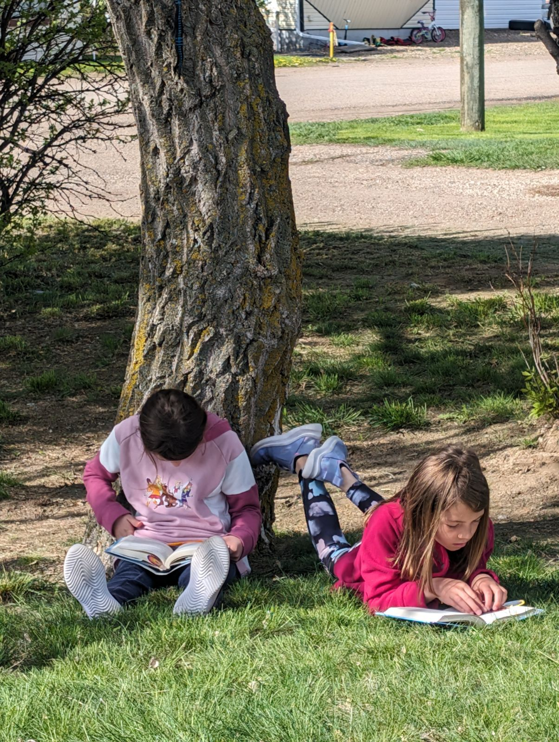
Schuler School
Education Plan
2024-2025
www.schuler.myprps.com

Slide 2
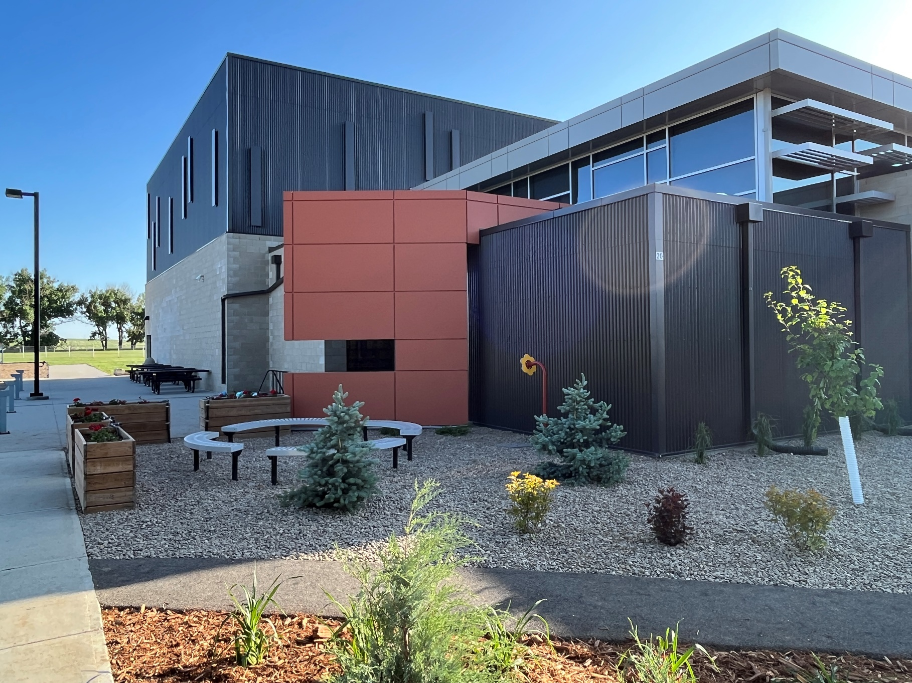
www.schuler.myprps.com
Principal's Message
Welcome to Schuler School
Dear Students, Families, and Community Members,
Welcome to Schuler School, where we take pride in being a cornerstone of learning, growth, and community in our rural setting. Our school is more than just a place for education; it’s a vibrant community hub where students are encouraged to explore their potential, foster meaningful connections, and cultivate the skills they need for a successful future. At Schuler School we strive to create a safe, inclusive, and nurturing environment that reflects our values of respect, collaboration, and a commitment to lifelong learning. Guided by the Prairie Rose School Division's six core principles—Connect, Create, Communicate, Care, Contribute, and Challenge—we aim to ignite curiosity, inspire creativity, and empower our students to make meaningful contributions to the world around them. We also recognize the importance of Truth and Reconciliation in fostering understanding and respect for all cultures, particularly the Indigenous peoples whose land we are honored to learn and grow on. Together, we will work to deepen our knowledge and take steps toward building a more inclusive future. This handbook has been designed to provide you with the information you need to navigate our school year successfully. It outlines our policies, procedures, and expectations, as well as opportunities for students and families to get involved in our school community. Thank you for entrusting us with your child’s education. We look forward to partnering with you in their journey of growth and achievement. Together, let’s kindle hearts, ignite minds, and forge futures!
Warm regards,
Lyle Kennedy
Principal
Schuler School Council
Chairperson: Jenn Beck
Vice Chairperson: Sarah Kirschenman
Secretary: Danielle McNeill
Treasurer: Jackie Hanson
01

Slide 3
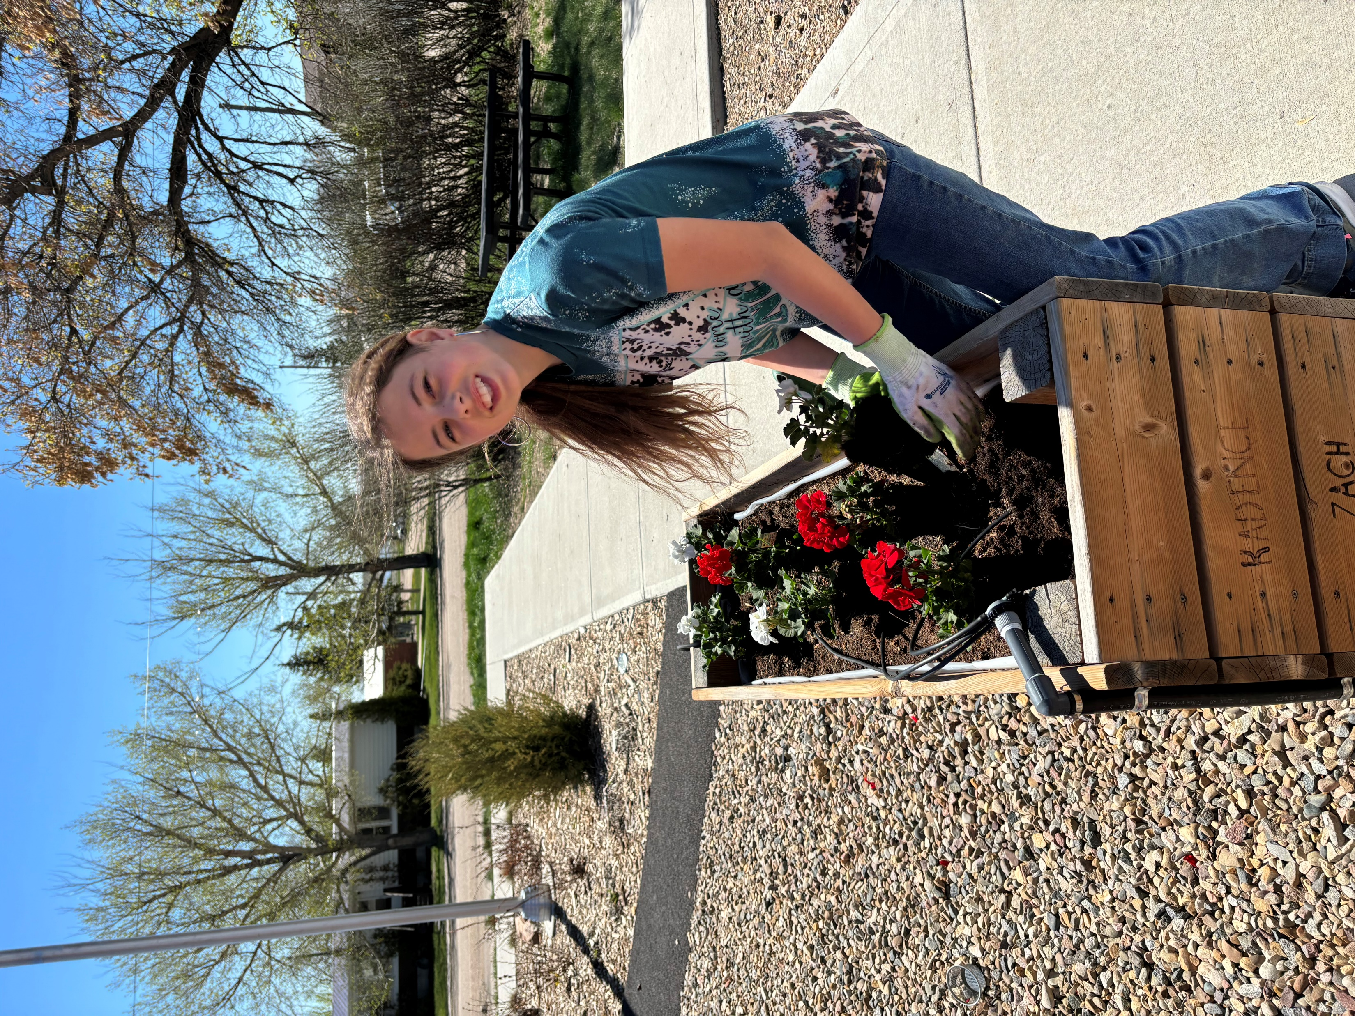



School Profile
www.schuler.myprps.com
School Address: 20 1 Ave W, Schuler, Alberta, TOJ 3B0
School Phone Number: 403-839-3732
80
Student enrollment Kindergarten ~ Grade 9
4
Self identified First Nations Metis Inuit Students
21
English language learners (ESL)
5.0
Full Time Equivalent Certified Teachers
4
Full-time Equivalent Support Staff
4
Number of Buses to the School

Slide 4
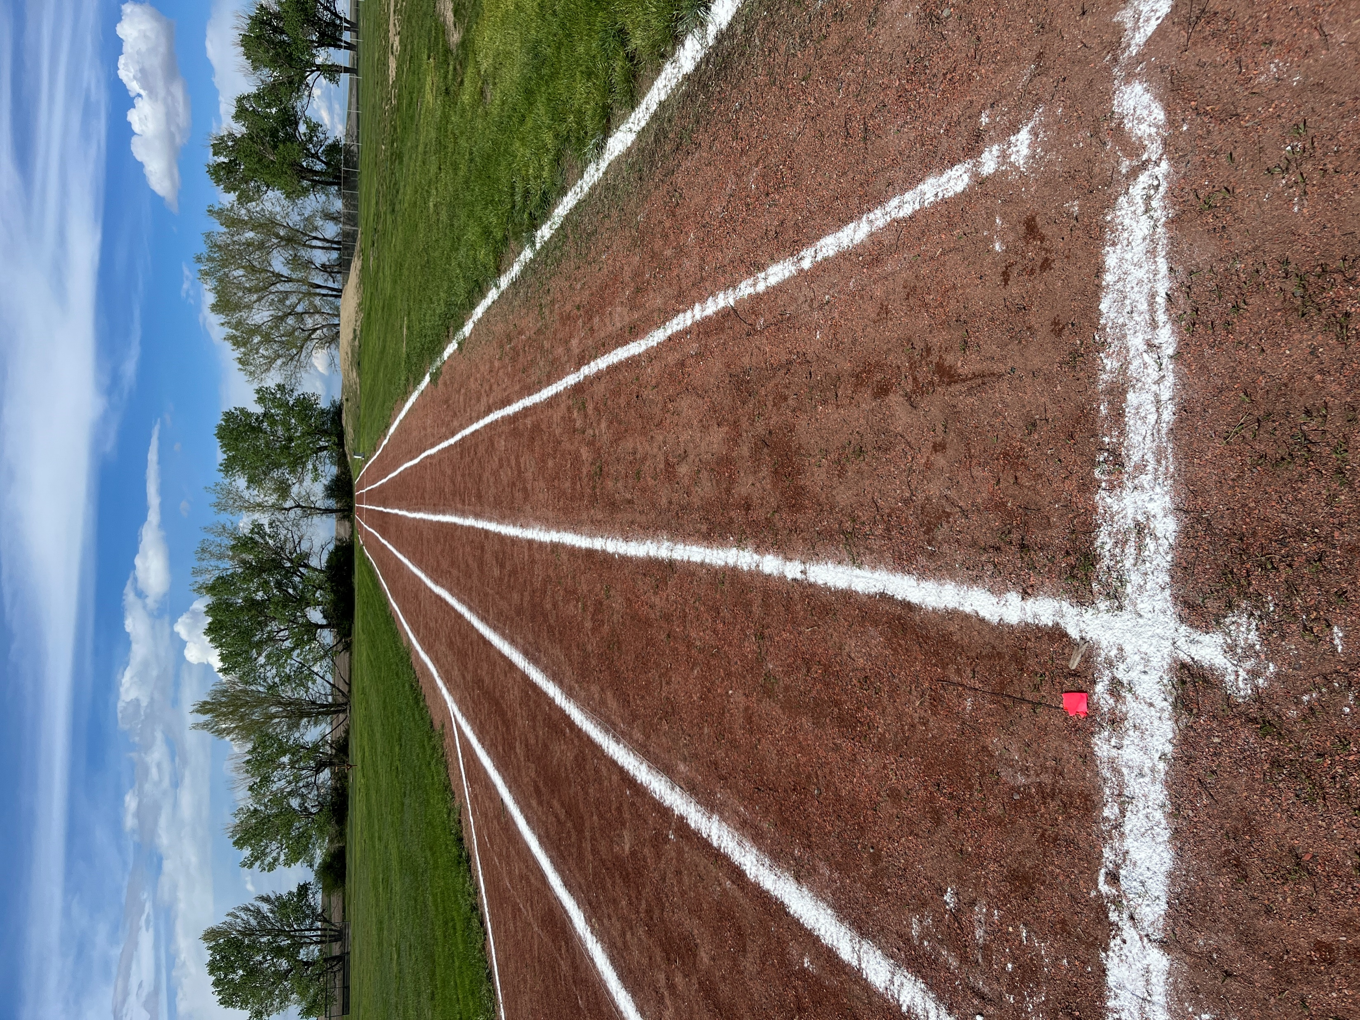
Our Vision
www.schuler.myprps.com
Preparing Students Today for the Achievements of Tomorrow
Our Mission
Let's Give Back...Not Sit Back
School Values
Using Clear and Honest Communication Resilience and Flexibility
Being Solution-Focused
Doing what is best for our students Being Responsible for Self
Having Integrity
Using Persistence and Perseverance Emphasizing Academic and Personal Excellence

Slide 5
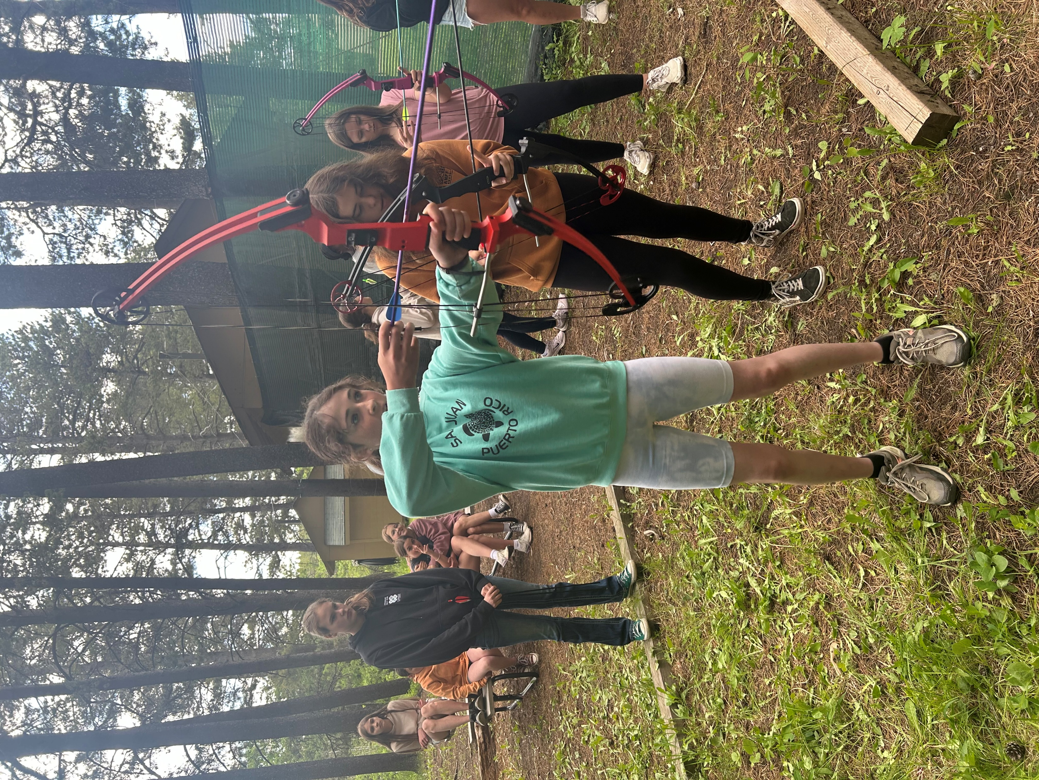
Stakeholder Engagement
www.schuler.myprps.com
"When schools, families, and community groups work together to support learning, children tend to do better in school, stay in school longer, and like school more. "
Anne Anderson and Karen Mapp
Parents and School Council
Google Form Surveys that gave parents the opportunity to volunteer and share expertise for CTF and Option Classes at Schuler School. School Council Meetings (focus in increased participation)
Informal and Formal Gatherings with parents (Spring Tea, Grade 9 Farewell, Field Trips, Parent Volunteers in School)
Teachers
Weekly Staff Meetings - keeping the lines of staff communication open
Generative Dialogue with individual teachers and scaffolded conversations as a teaching staff
Ensuring there are Distributed Leadership Opportunities Informal and on-going conversations
Support Staff
Weekly EA meetings - keeping the lines of staff communication open
Individual conversations
Ensuring there are Distributed Leadership Opportunities
Students
Student Council Weekly Assemblies Informal opportunities for idea sharing
Community Groups
Schuler Community Association - focus on strengthening relationship with community (ie- shared Remembrance Day Ceremony, Shared Community Christmas Celebration, community clean-up)
Drowning Ford Grazing Association - reaching out to propose future planning and mutual partnership

Slide 6
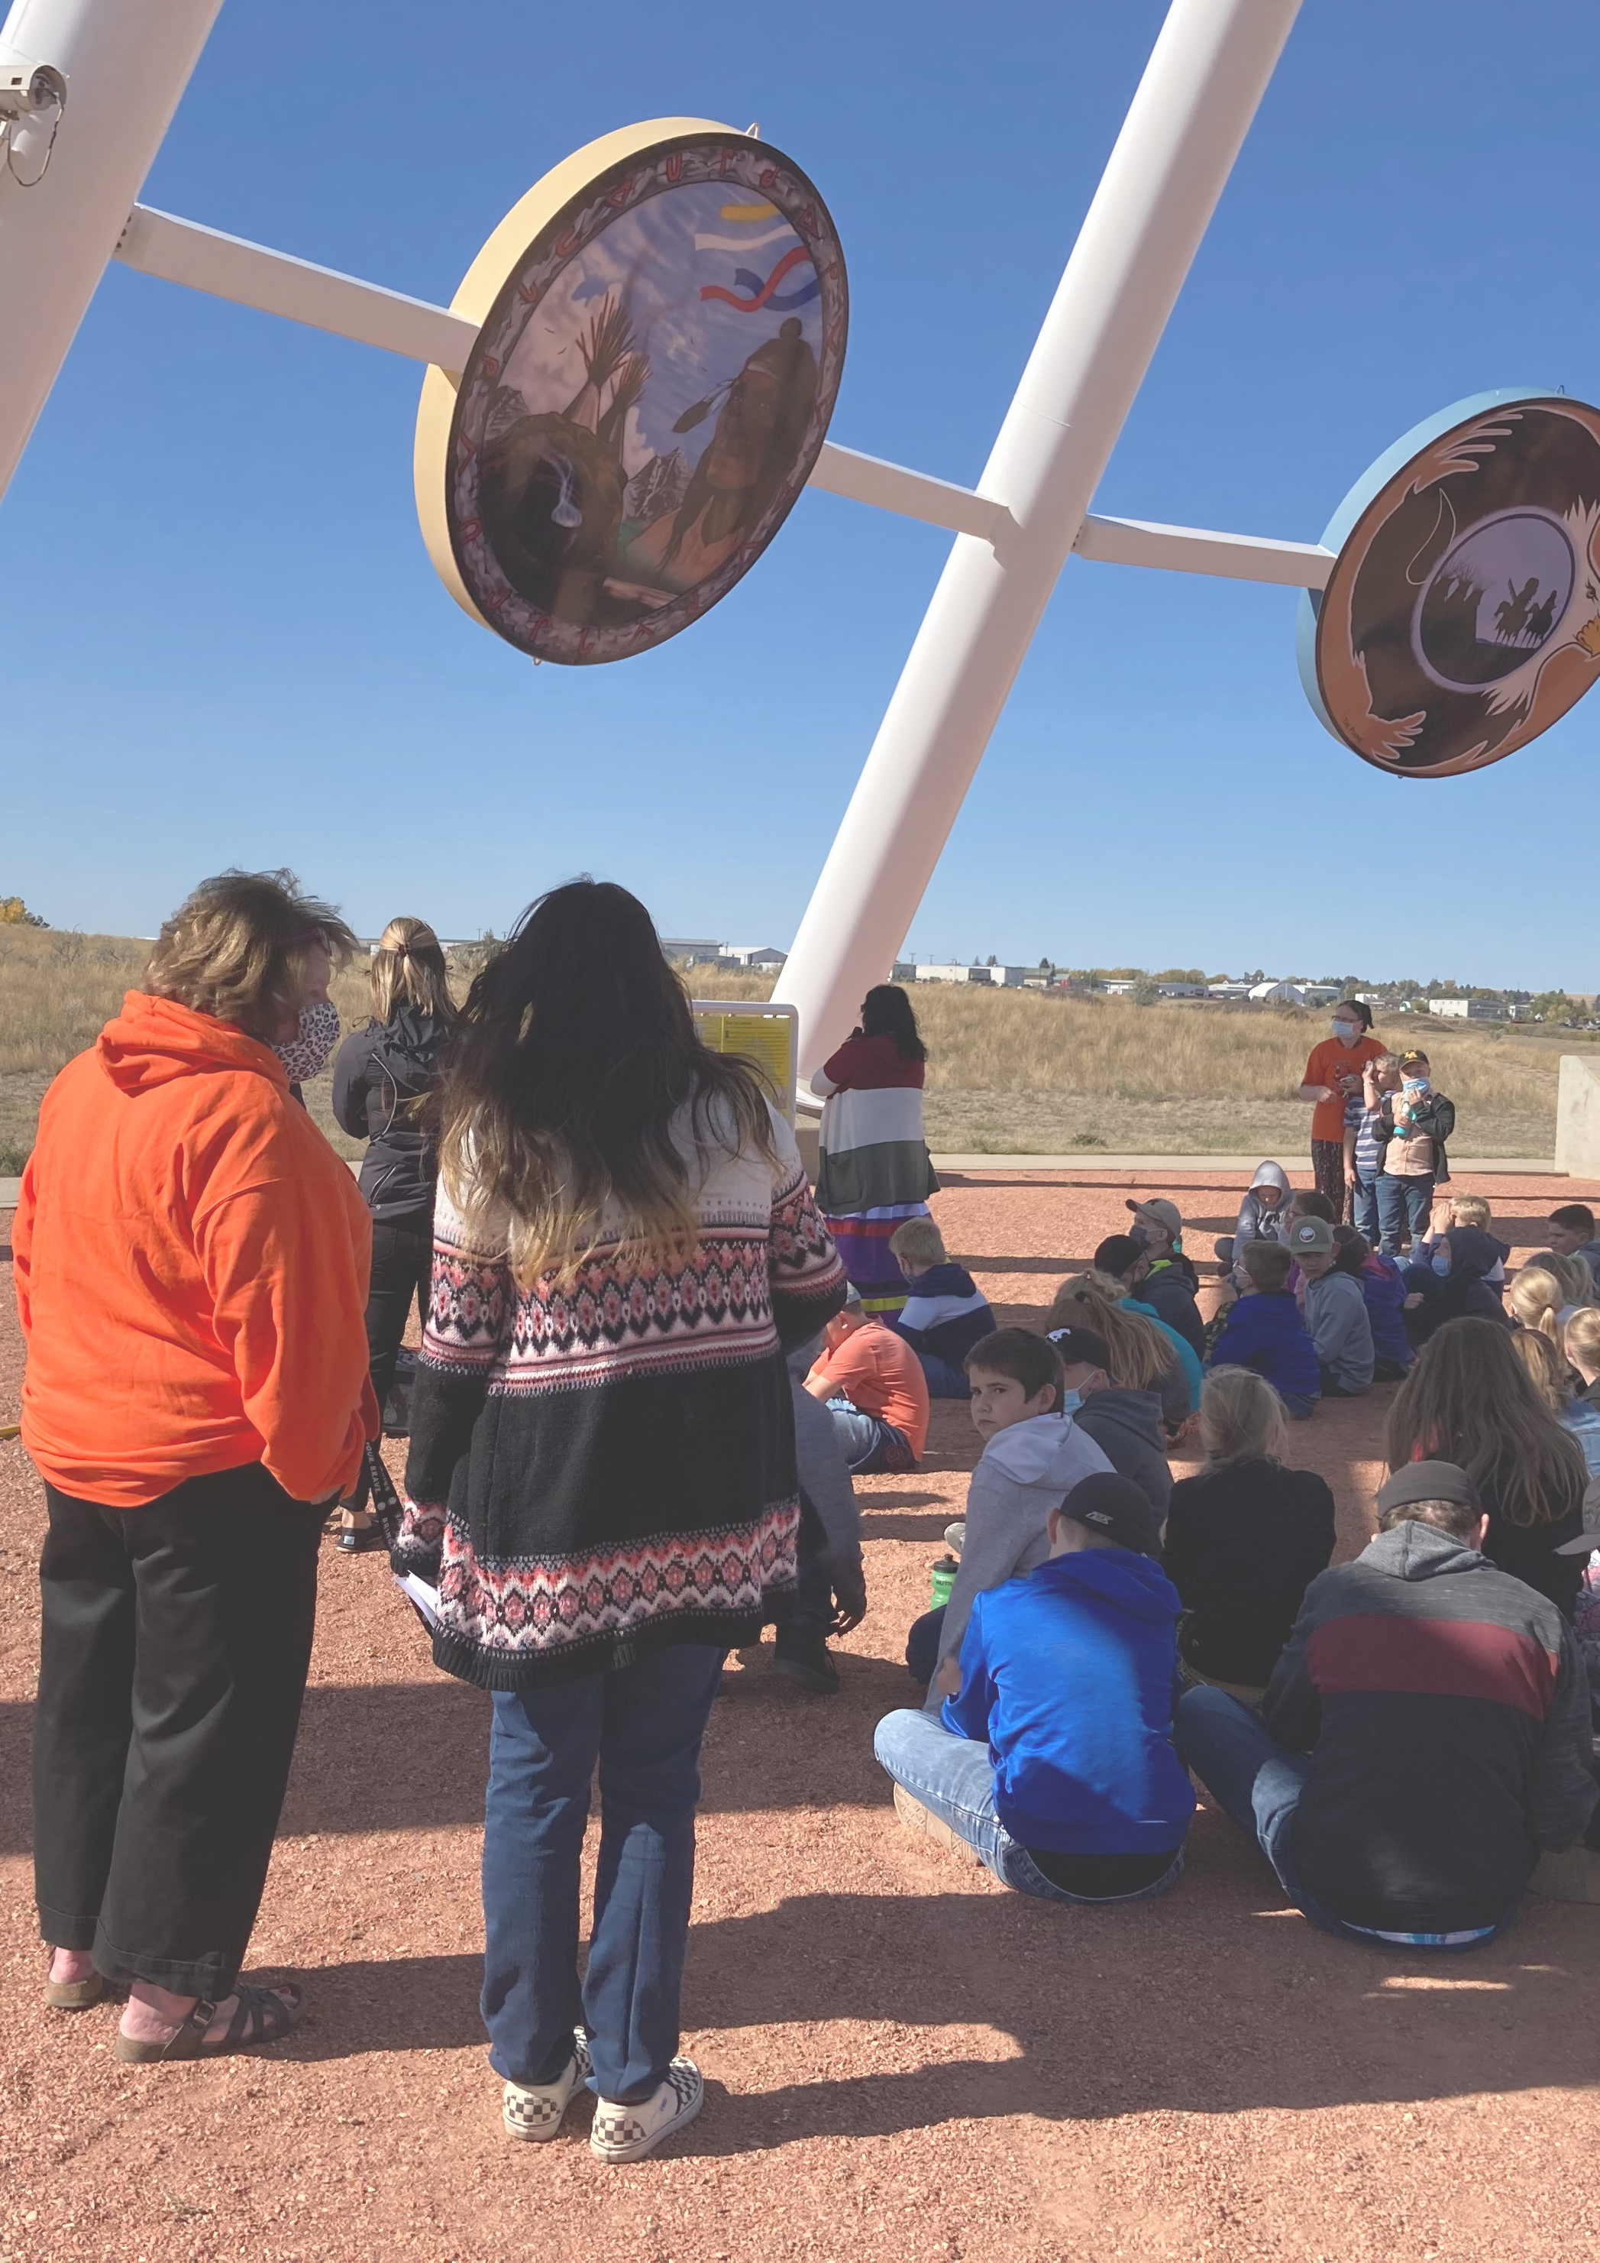
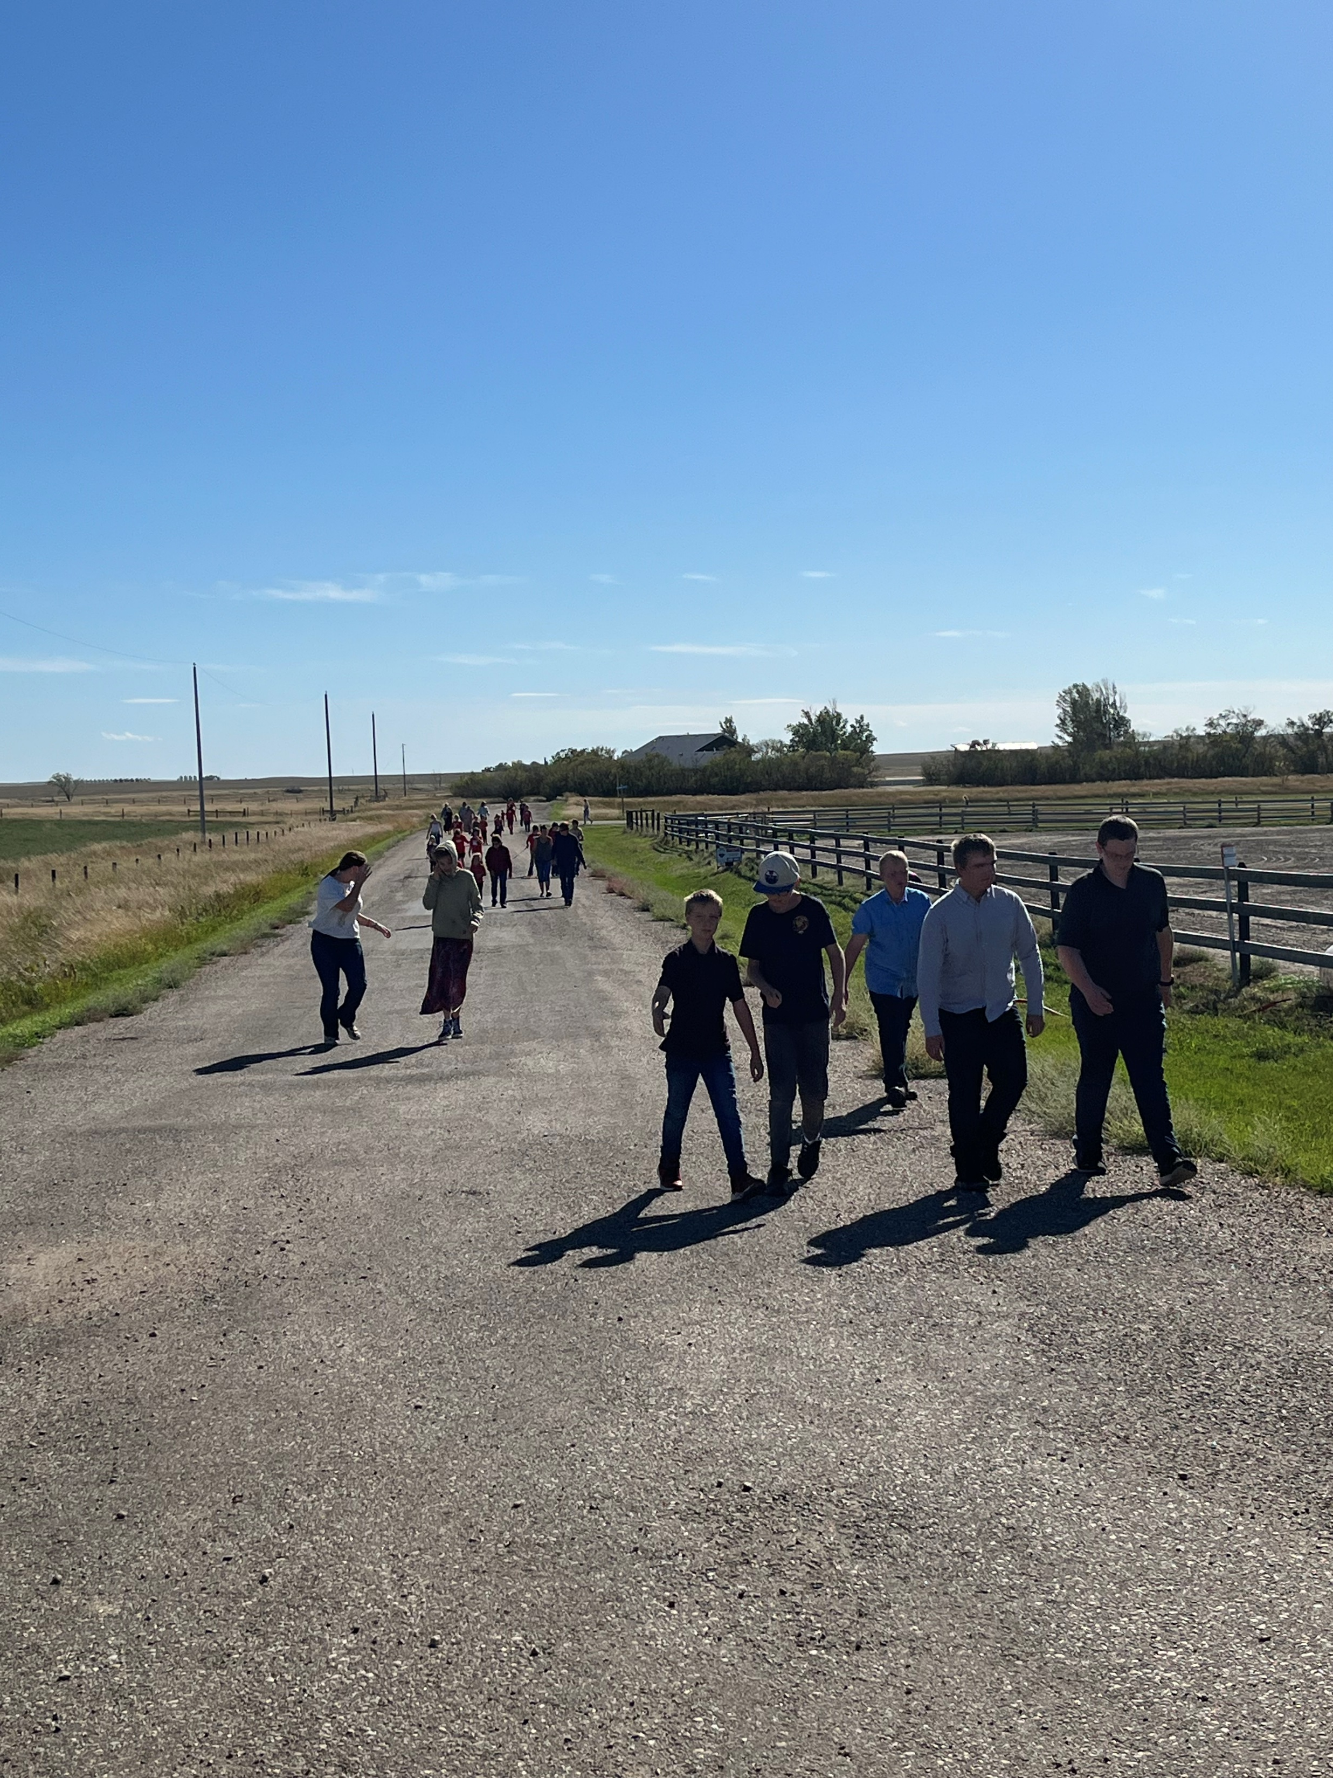

Assurance Framework
www.schuler.myprps.com
What is the Assurance Framework?
In the Assurance Framework, all education stakeholders accept responsibility for building capacity of the education system — in classrooms, schools, school authorities and in government. Ensuring continuous improvement throughout the system necessitates a collective approach that recognizes diversity within Alberta, relies on evidence to make decisions, and is responsive to the needs of students in their local contexts.
The Five Domains of Assurance
Student Growth and Achievement
Teaching and Leading
Learning Supports
Governance
Assurance in the education system happens when community members, system stakeholders and education partners engage across the five domains.
Source: 2022 Funding Manual for School Authorities
Local and Societal Context

Slide 7
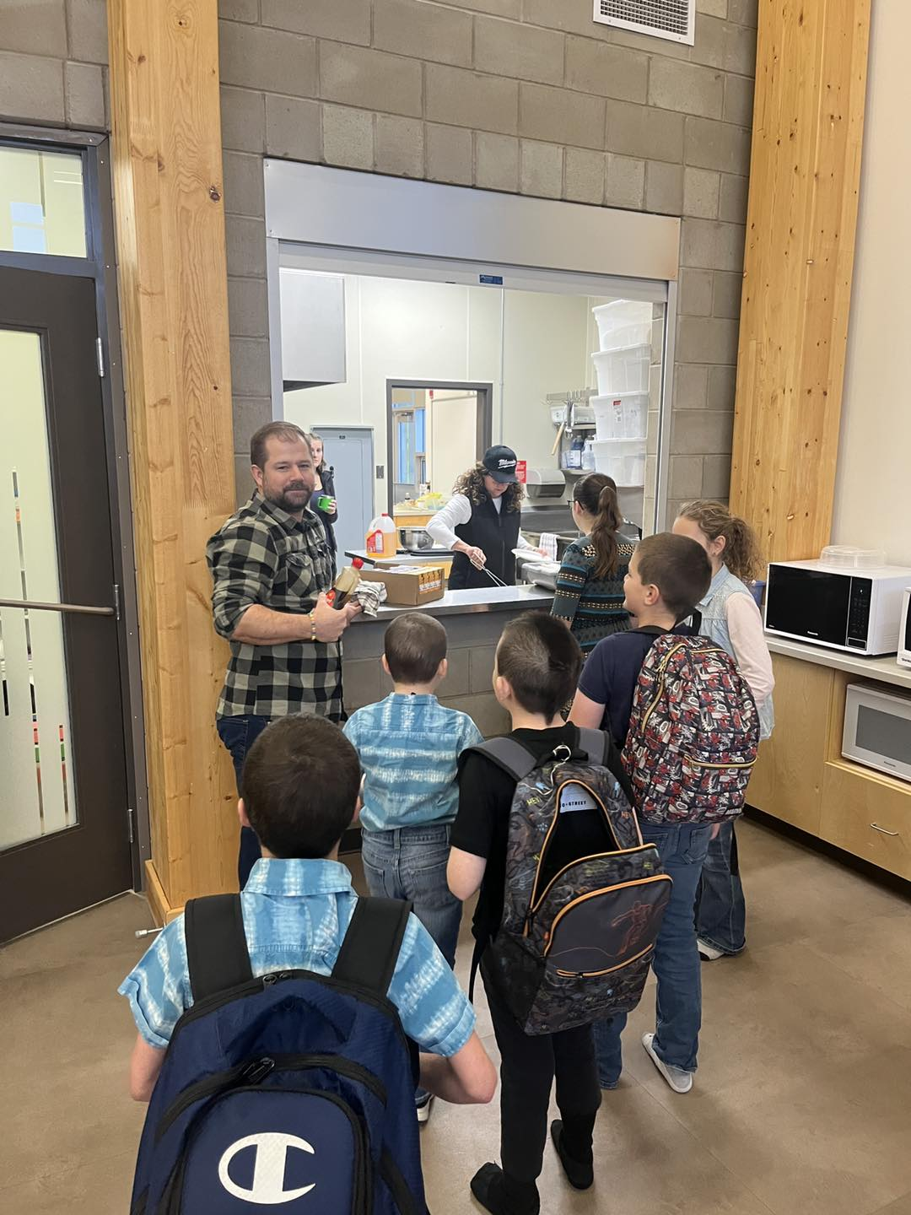
Result Driven Decision-Making
www.schuler.myprps.com
DOMAIN 1:
Student Growth and Achievement
0
0
0
0
Student Learning Engagement Citizenship
3-Yr High School Completion Rate
5-Yr High School Completion Rate
0
0
0
0
PAT Acceptable PAT Excellence
Diploma Acceptable Diploma Excellence
DOMAIN 2:
Teaching and Leading
0 Education Quality
DOMAIN 3:
Learning Supports
0
0
Welcoming, Caring, Respectful and Safe Learning Environments
Access to Supports and Services
DOMAIN 4:
Governance
0 Parental Involvement
DOMAIN 5:
Local and Societal Context
Prairie Rose Possibilities
We are excited to begin our Prairie Rose Possibilities Project based on utilizing our Commercial kitchen in a variety of ways. Starting with weekly hot breakfast to expert guest presenters to help us decide where we head with our project in year 2 and 3.
Numbers based on the Spring 2021 Accountability Pillar Results.

Slide 8
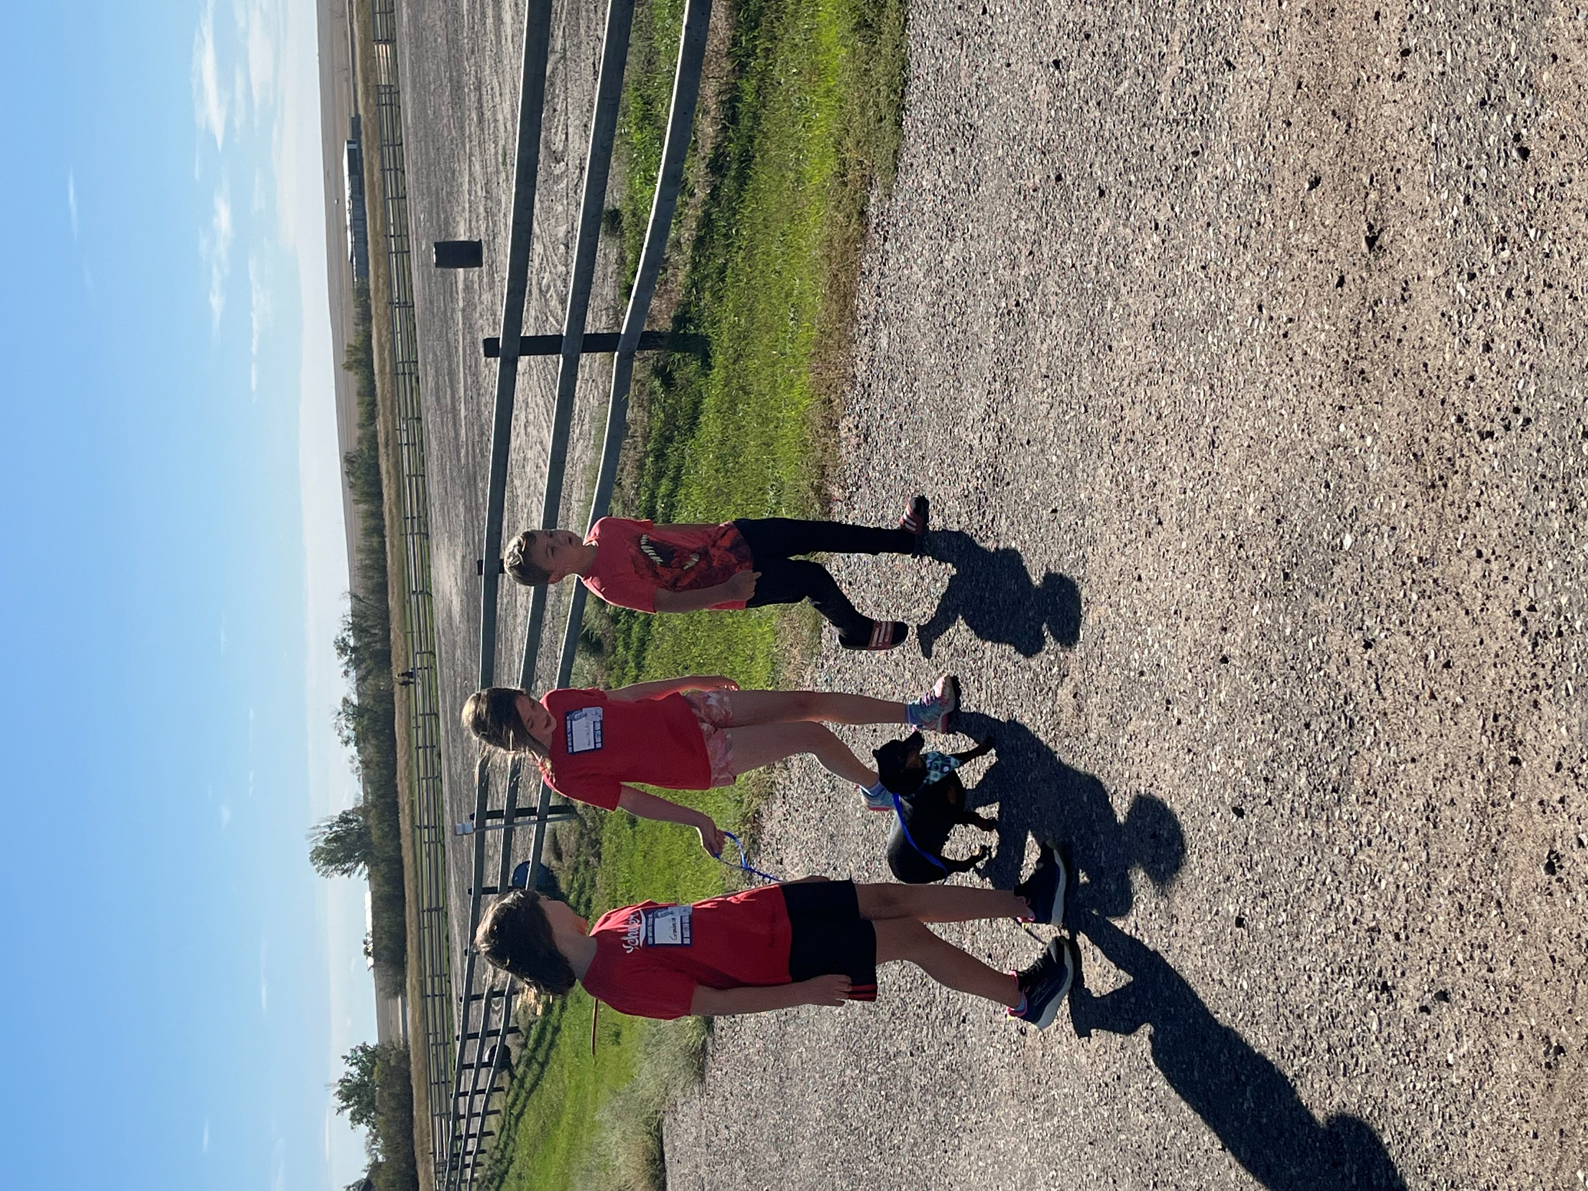
PRPS Core Principles
www.schuler.myprps.com
Connect
School structures and traditions ensure that every student, staff and community member is known and cared for and contributions are celebrated.
Create
Students and PRPS staff undertake tasks that require perseverance, craftsmanship, imagination and self-discipline to foster curiosity about the world.
Communicate
Words have tremendous power and ours will be characterized by mutual respect, belonging, and community building. Students and PRPS staff use communication skills to advocate for themselves, understand their communities and tackle the world’s biggest challenges.
Care
Students and PRPS staff have the knowledge of how to care for their physical and mental health and support the well-being of others fostering a safe school environment.
Contribute
Students and PRPS staff are strengthened by acts of consequential service to others, actively ensure all belong, and participate and celebrate their rural communities.
Challenge
Students and PRPS staff develop an internal drive and desire to overcome obstacles and maximize performance through personal responsibility, resilience and initiative.

Slide 9
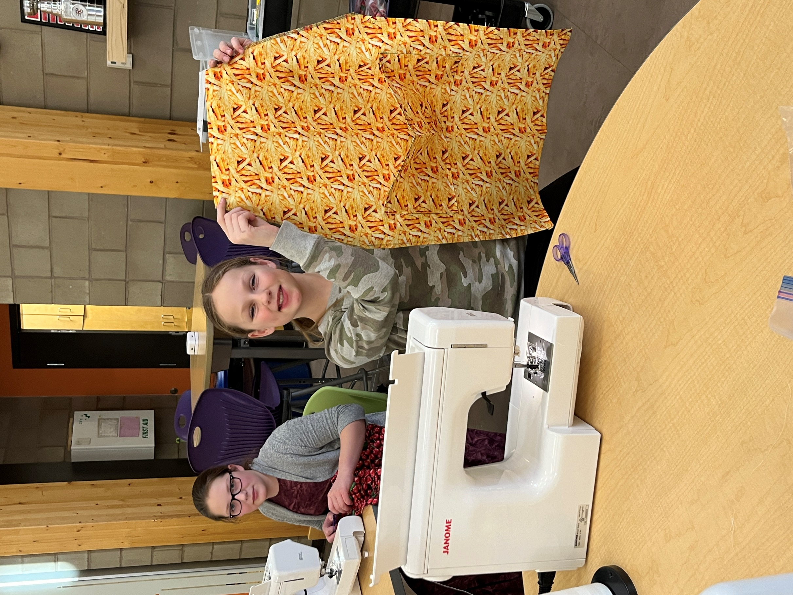


Prairie Rose Public Schools Learning Model
www.schuler.myprps.com
At the end of the current year the Prairie Rose Public Schools strategic plan will conclude. As a result, consultation this year focused on establishing a new learning model based on what the people we serve envision for the future. This feedback has resulted in refocused Vision and Mission statements, the establishment of six Core Principles and new strategic goals.
Ignite Minds Kindle Hearts Forge Futures
Contribute
create cultures of academic excellence
I G N I T E M I N D S
Connect
Care
Communicate
F O R G E
K I N D L E
F U T U R E S
H E A R T S
cultivate curiosity,
wonder and possibility
prioritize wellbeing,
connection and service
Challenge
Create

Slide 10
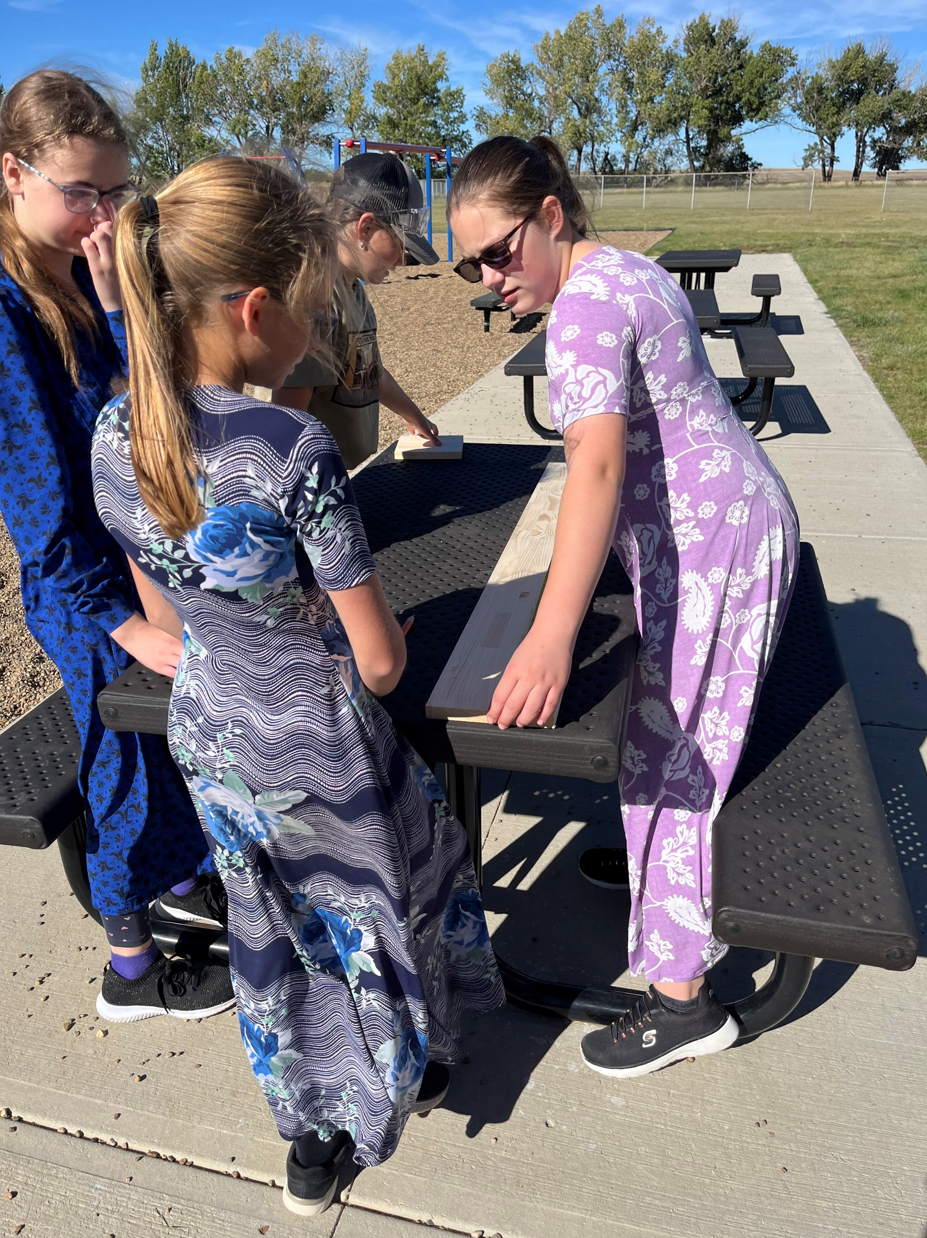
www.schuler.myprps.com
PRPS GOAL 1: IGNITE MINDS
Background: We will ignite minds by creating cultures of academic excellence
Conceptual understanding, deeper learning and transfer are evident in all Prairie Rose classrooms Students have the background knowledge they need to be grounded, the scaffolding they need to be supported and the academic courage they need to explore possibilities
All students have the foundational knowledge in literacy and numeracy from which deeper learning grows
PRPS Core Principles are evident in the intellectual and academic pursuits of students and staff
PRPS GOAL 2: KINDLE HEARTS
Background: We will kindle hearts by prioritizing wellbeing, belonging and service.
Staff and students take care of themselves and others
Staff and students contribute to their communities and create belonging Environments are cultivated that inspire people to show up as their best selves PRPS Core Principles are evident in our culture
PRPS GOAL 3: FORGE FUTURES
Background: Futures will be forged by cultivating wonder and possibilities.
We offer programs and instruction that stretch what staff and students thought possible and sets PRPS apart
government in the communities we serve Students are engaged, motivated and resilient Future prospects for PRPS students are abundant
PRPS Core Principles are evident in the initiatives and endeavors of students and staff
PRPS provides personalized, place based and multiple pathways to meet the diverse needs of families
Empower students to be confident communicators in a variety of formats
Strong partnerships with the families, businesses, nonprofits, and local
The full PRPS Education Plan can be found here: Link to the Plan

Slide 11
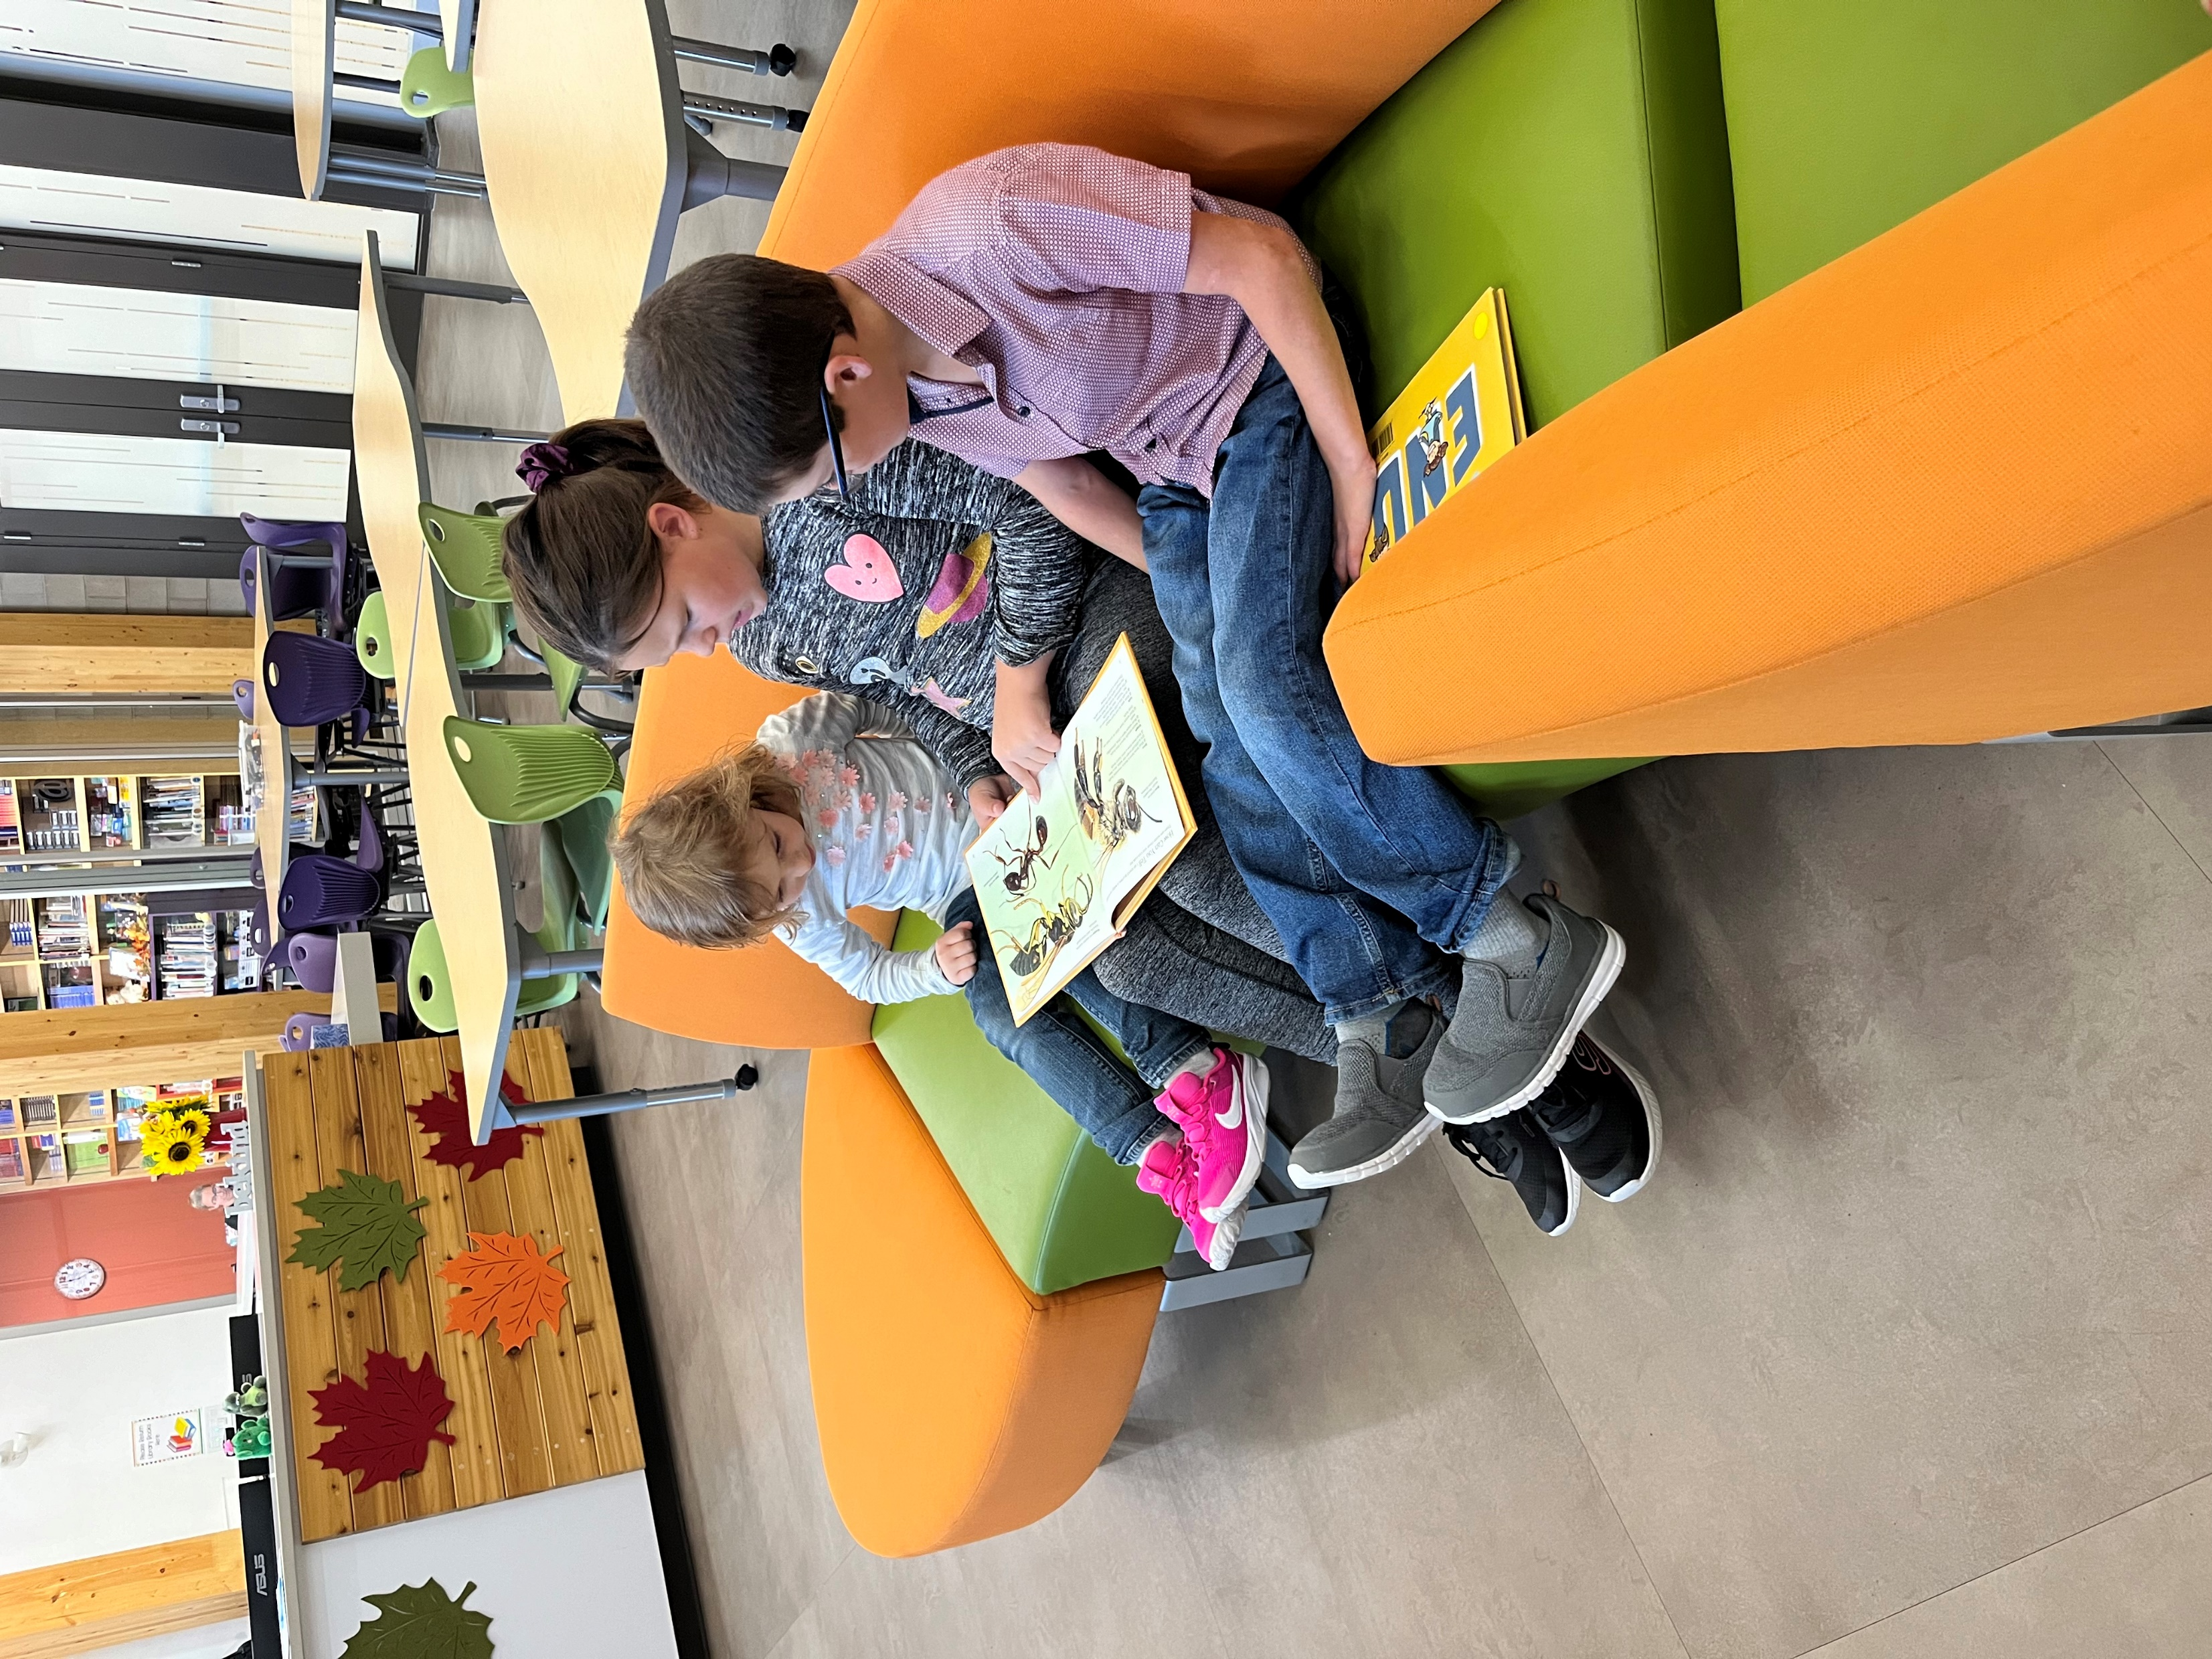


www.schuler.myprps.com
PRPS GOAL 1: IGNITE MINDS
Background: We will ignite minds by creating cultures of academic excellence
SCHOOL BASED STRATEGIES
This year, Schuler School will continue to emphasize continued literacy growth in our students from Kindergarten to grade 9.
Specifically, we will focus our instructional strategies on orthographic mapping and syllabication. Every word has three forms: its sounds (phonemes), its orthography (spelling) and its meaning. In addition, syllibication will be emphasized as it helps to build a solid foundation in literacy.
Resources such as Heggerty, Secret Stories, the Science of Reading along with enlisting the expertise of our instructional coaches and their website will help us become more confident educators in literacy skills.
SCHOOL BASED PERFORMANCE MEASURES
MAP testing
F and P Benchmarks

Slide 12
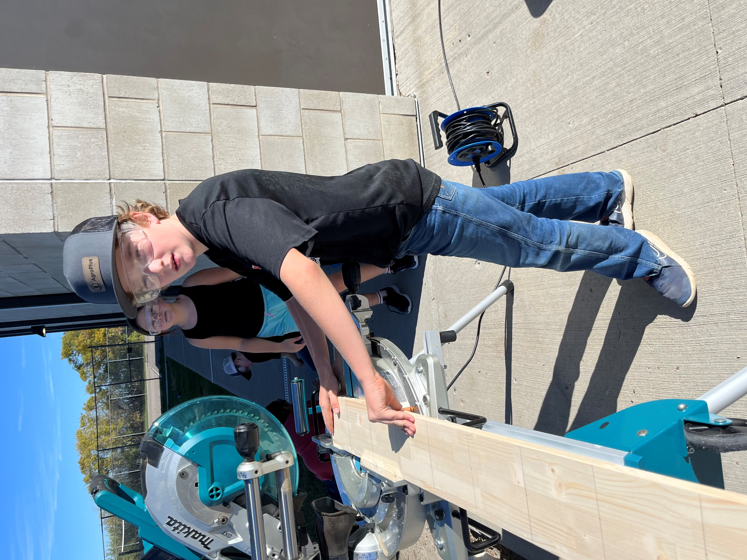
www.schuler.myprps.com
PRPS GOAL 2: KINDLE HEARTS
Background: We will kindle hearts by prioritizing wellbeing, belonging and service.
SCHOOL BASED STRATEGIES
Student Wellness will be highlighted through:
Weekly Health and Wellness classes for grades 1-9 Mental Health Capacity Building
Small group or individual sessions with our FSLW (Teresa Kleinknecht) as necessary.
Weekly assemblies which, this year, will focus on the 7 Sacred Teachings. With each teaching, one student will be chosen for living that teaching in an outstanding way.
A CALM room will be an added space where students who need to experience a sense of CALM can go so that they feel ready to learn.
Staff Wellness will be highlighted through:
HONE Survey's - navigating difficulties that come up through acknowledging them and determining action plans Professional Development activities such as recognizing workplace burnout and how to avoid it
Established norms for professional communication and collaboration
Students will increasingly feel a sense of belonging, and service to others with decreasing amounts of unsolved conflicts with each other. We will have increased success in learning because students will be regulated and ready to learn.
Staff will feel a greater sense of wellness and efficacy (results in HONE survey should remain steady and high).

Slide 13
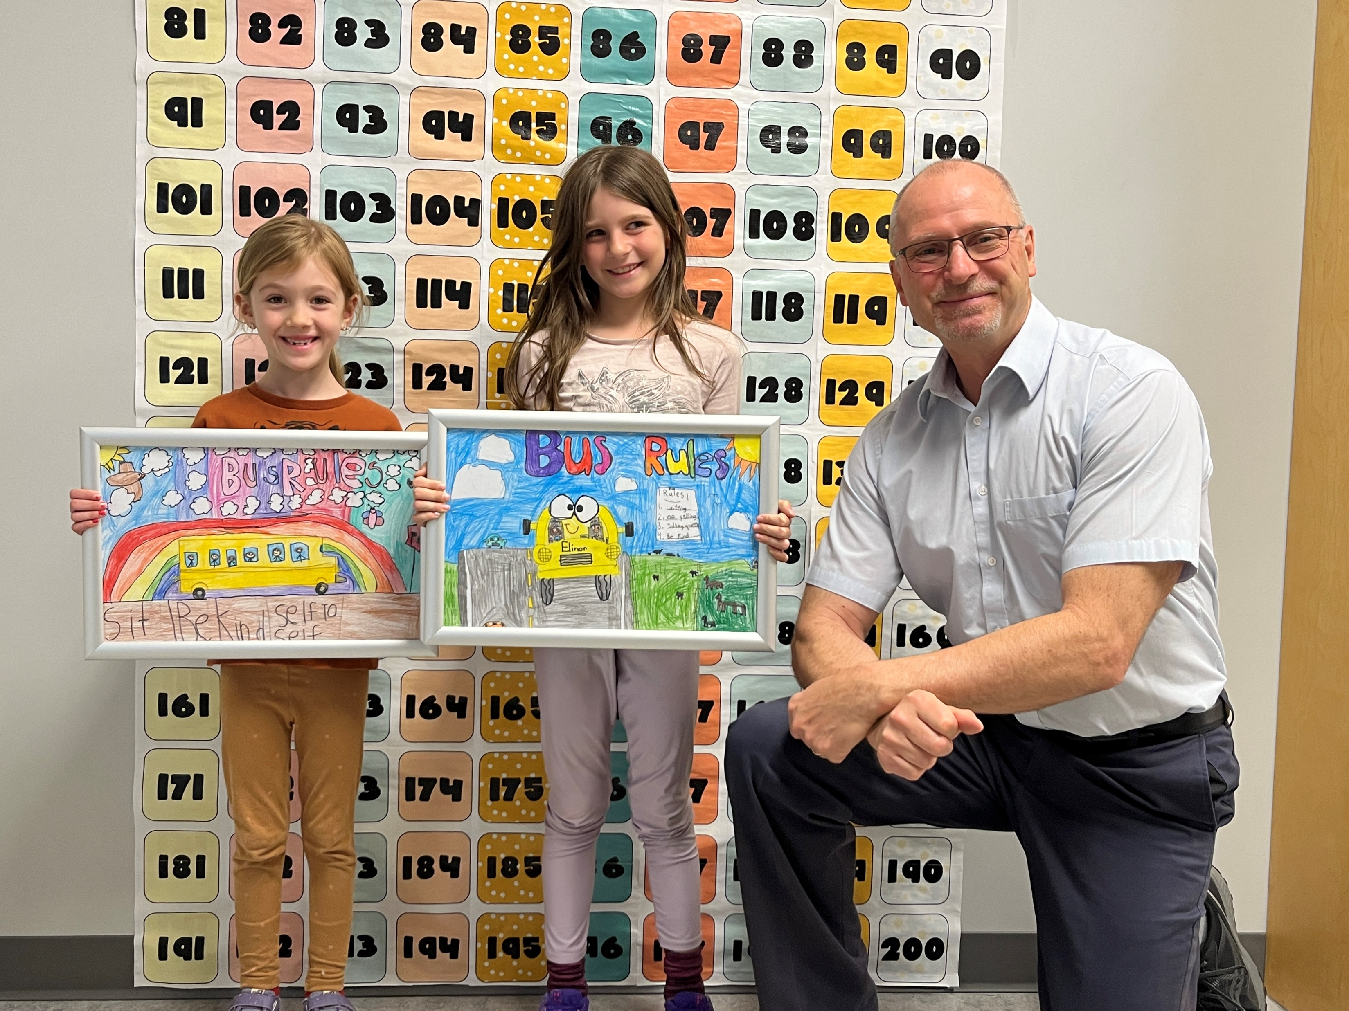
www.schuler.myprps.com
PRPS GOAL 3: FORGE FUTURES
Background: Futures will be forged by cultivating wonder and possibilities.
SCHOOL BASED STRATEGIES
Schuler Centennial Exhibition of Learning GIANT INTERACTIVE HISTORICAL MAP: providing students with learning opportunities that will help them understand the history of their community and invite the community to become active members of our school community through linked partnerships that investigate our collective history. A sense of community will be developed using our mapping skills, research skills, interviewing skills, photography skills, and technology skills (Drones, etc).
Developing an outdoor sensory space: We envision a space that includes:
Stimulation for multiple senses in many different ways
A walking area for active interaction
Areas to sit for quiet and calming for multiple users at once
Pieces that encourage interaction from disabled children
Room for as many senses as make sense outdoors (touch, hearing, sight)
Providing our students with opportunities through CTF classes to engage in Resilience Building: Equestrian work
Service Learning Team Challenges
SCHOOL BASED PERFORMANCE MEASURES
Pre and Post Surveys on questions related to resilience as students experience the challenges and activities of the Road to Resilience Academy (RRA).
Increased pro-social activities in the classroom, in the school community, and in the community at large. Decreased referrals to FSLW for anxiety/depression as students develop skills and confidence
“Stress is the number one cause of medical visits in this country; if we are to prepare our children to live in the 21st century, than we need to teach them the skills to deal with stress and promote physical and emotional wellness.
Resiliency skills are as important for our children and teens as any other skill they will learn in school, because these are skills they will need to call upon in all aspects of their lives.” Dr. Herbert Benson
Mind Body Medicine Pioneer
"A recent study by the Hospital for Sick Children in Ontario found a staggering 67–70 percent of children/adolescents experienced deterioration in at least one of six mental health domains during the COVID-19 pandemic: depression, anxiety, irritability, attention, hyperactivity, and obsessions/compulsions."
(Cost et al., 2021).

Slide 14
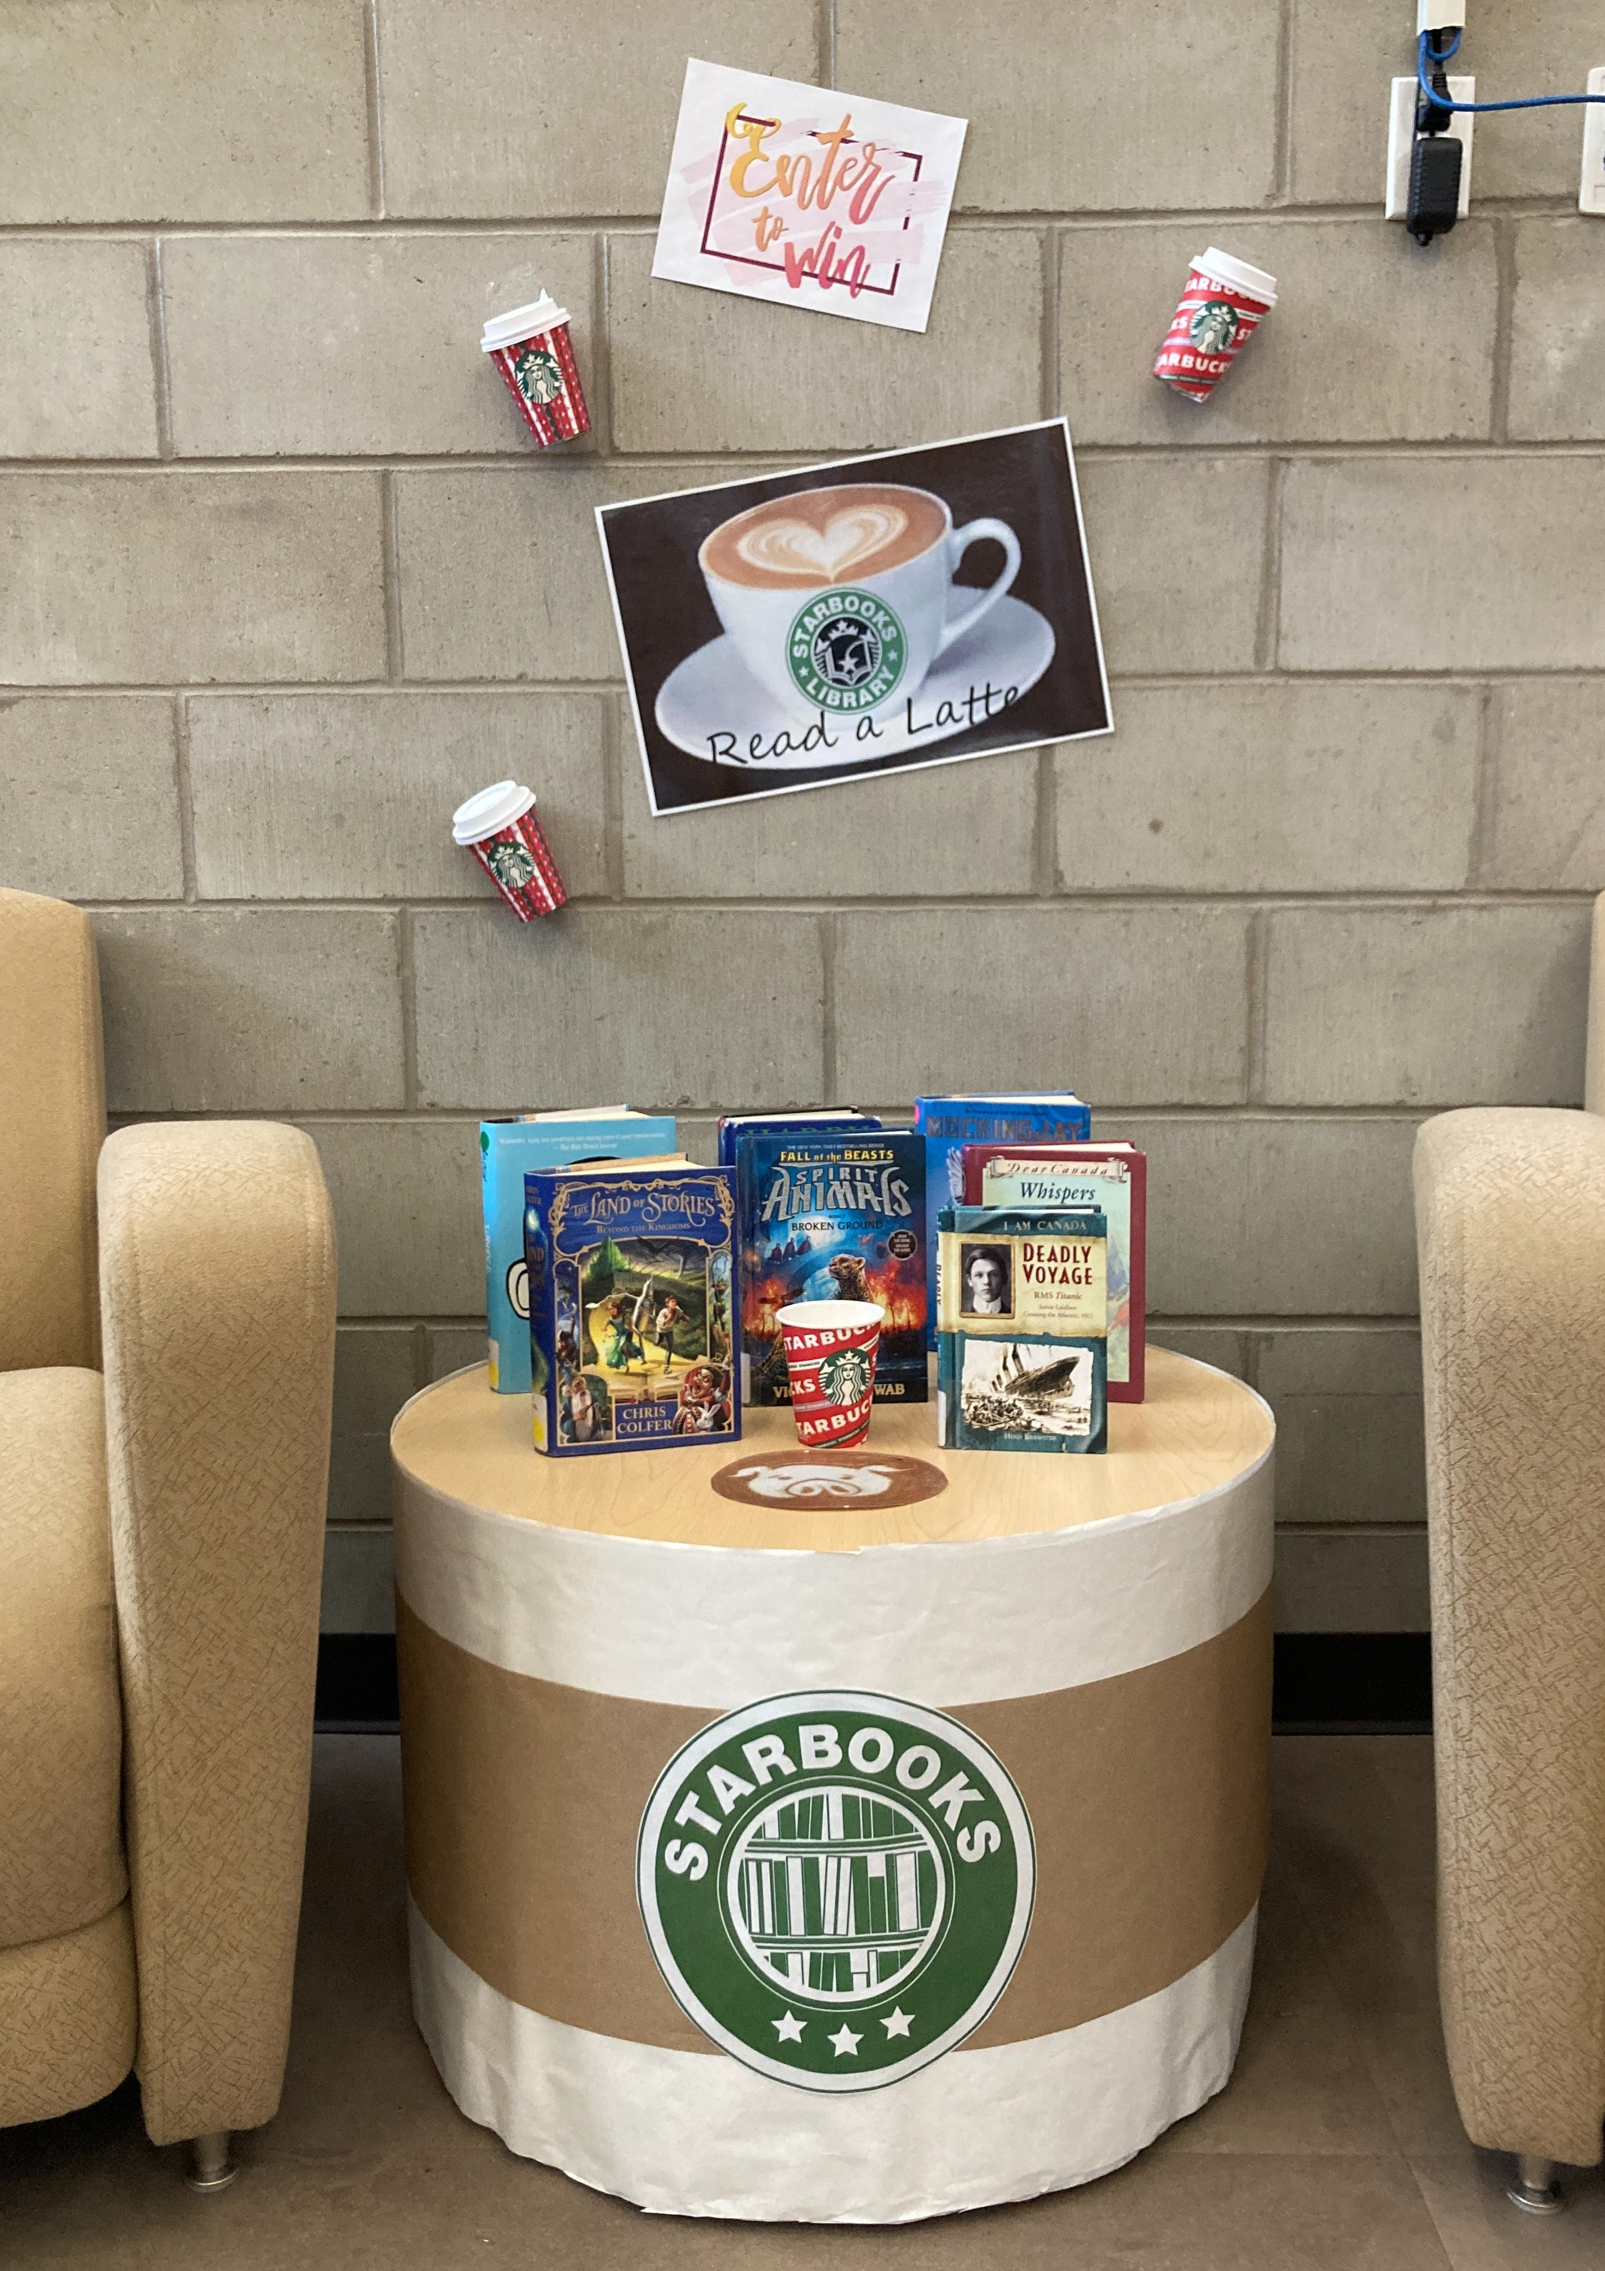
Supporting English as a Second Language Learners
www.schuler.myprps.com
SCHOOL BASED STRATEGIES
Ensure that daily instruction includes:
explicit reteaching and reinforcing of subject-specific vocabulary levelled literacy intervention
Culturally responsive teachers know their students well and build on students’ prior knowledge, stretching them beyond the familiar in a safe and encouraging classroom environment. They value the diverse knowledge and experiences students bring to class rather than seeing differences as problems to be overcome. They facilitate respect and empathy
among students as members of a diverse society. (Glaze, Mattingly and Levin 2012)

Slide 15
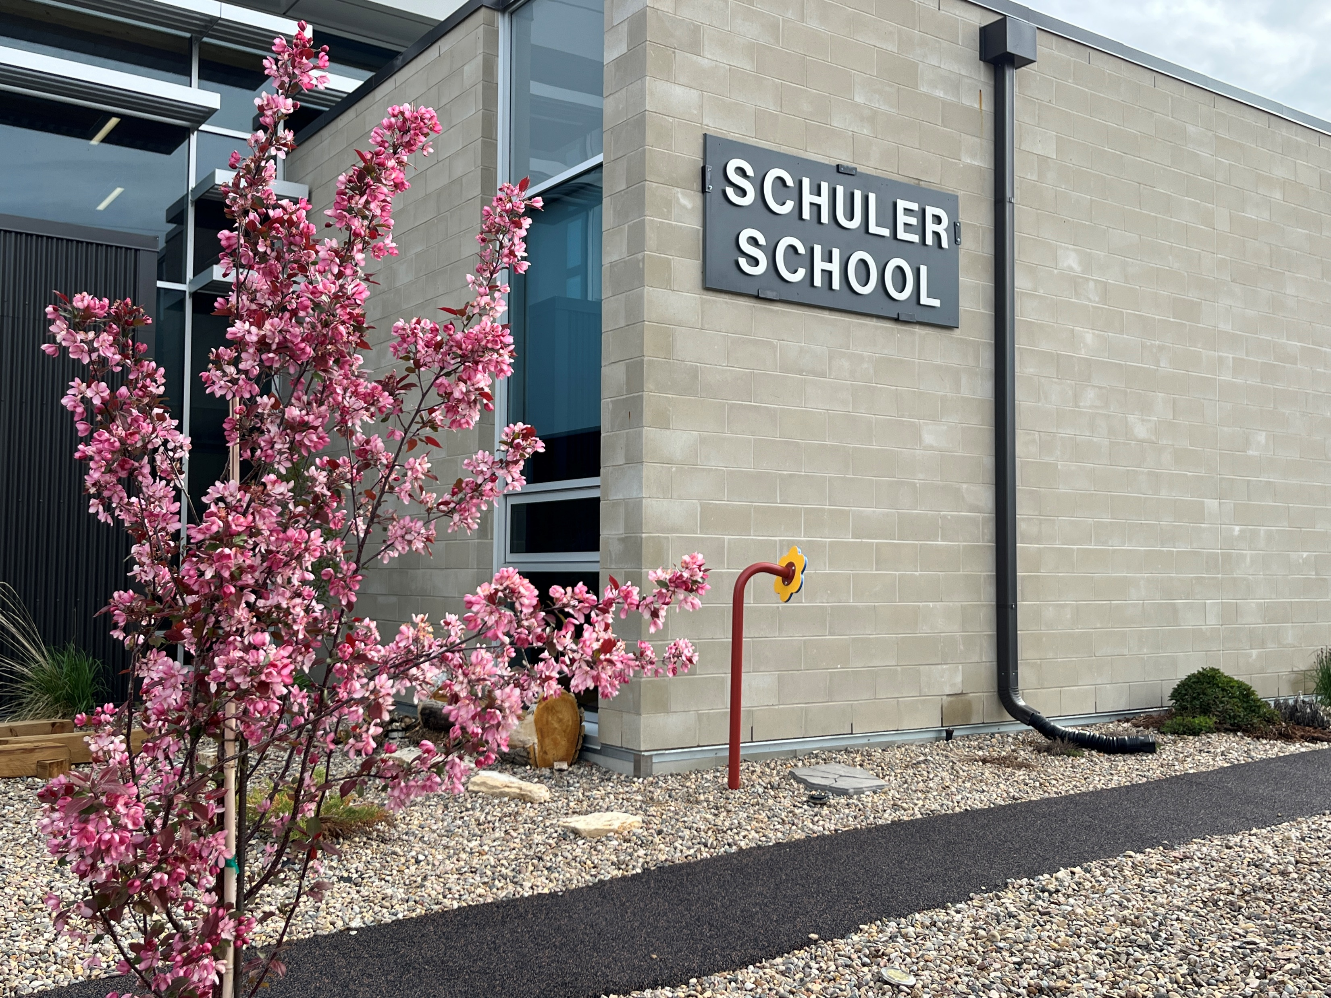
www.schuler.myprps.com
Budgeting Priorities
2024-2025 Budget Summary
Schuler School creates a budget in alignment with division priorities to drive academic excellence, social and emotional wellbeing and deeper learning, while addressing the operational needs of the school. Teaching and Learning is the area the majority of our resources our utilized with the following priorities guiding our budgetary process:
Classroom supports
Student, staff and community wellbeing Educational opportunities

Slide 16
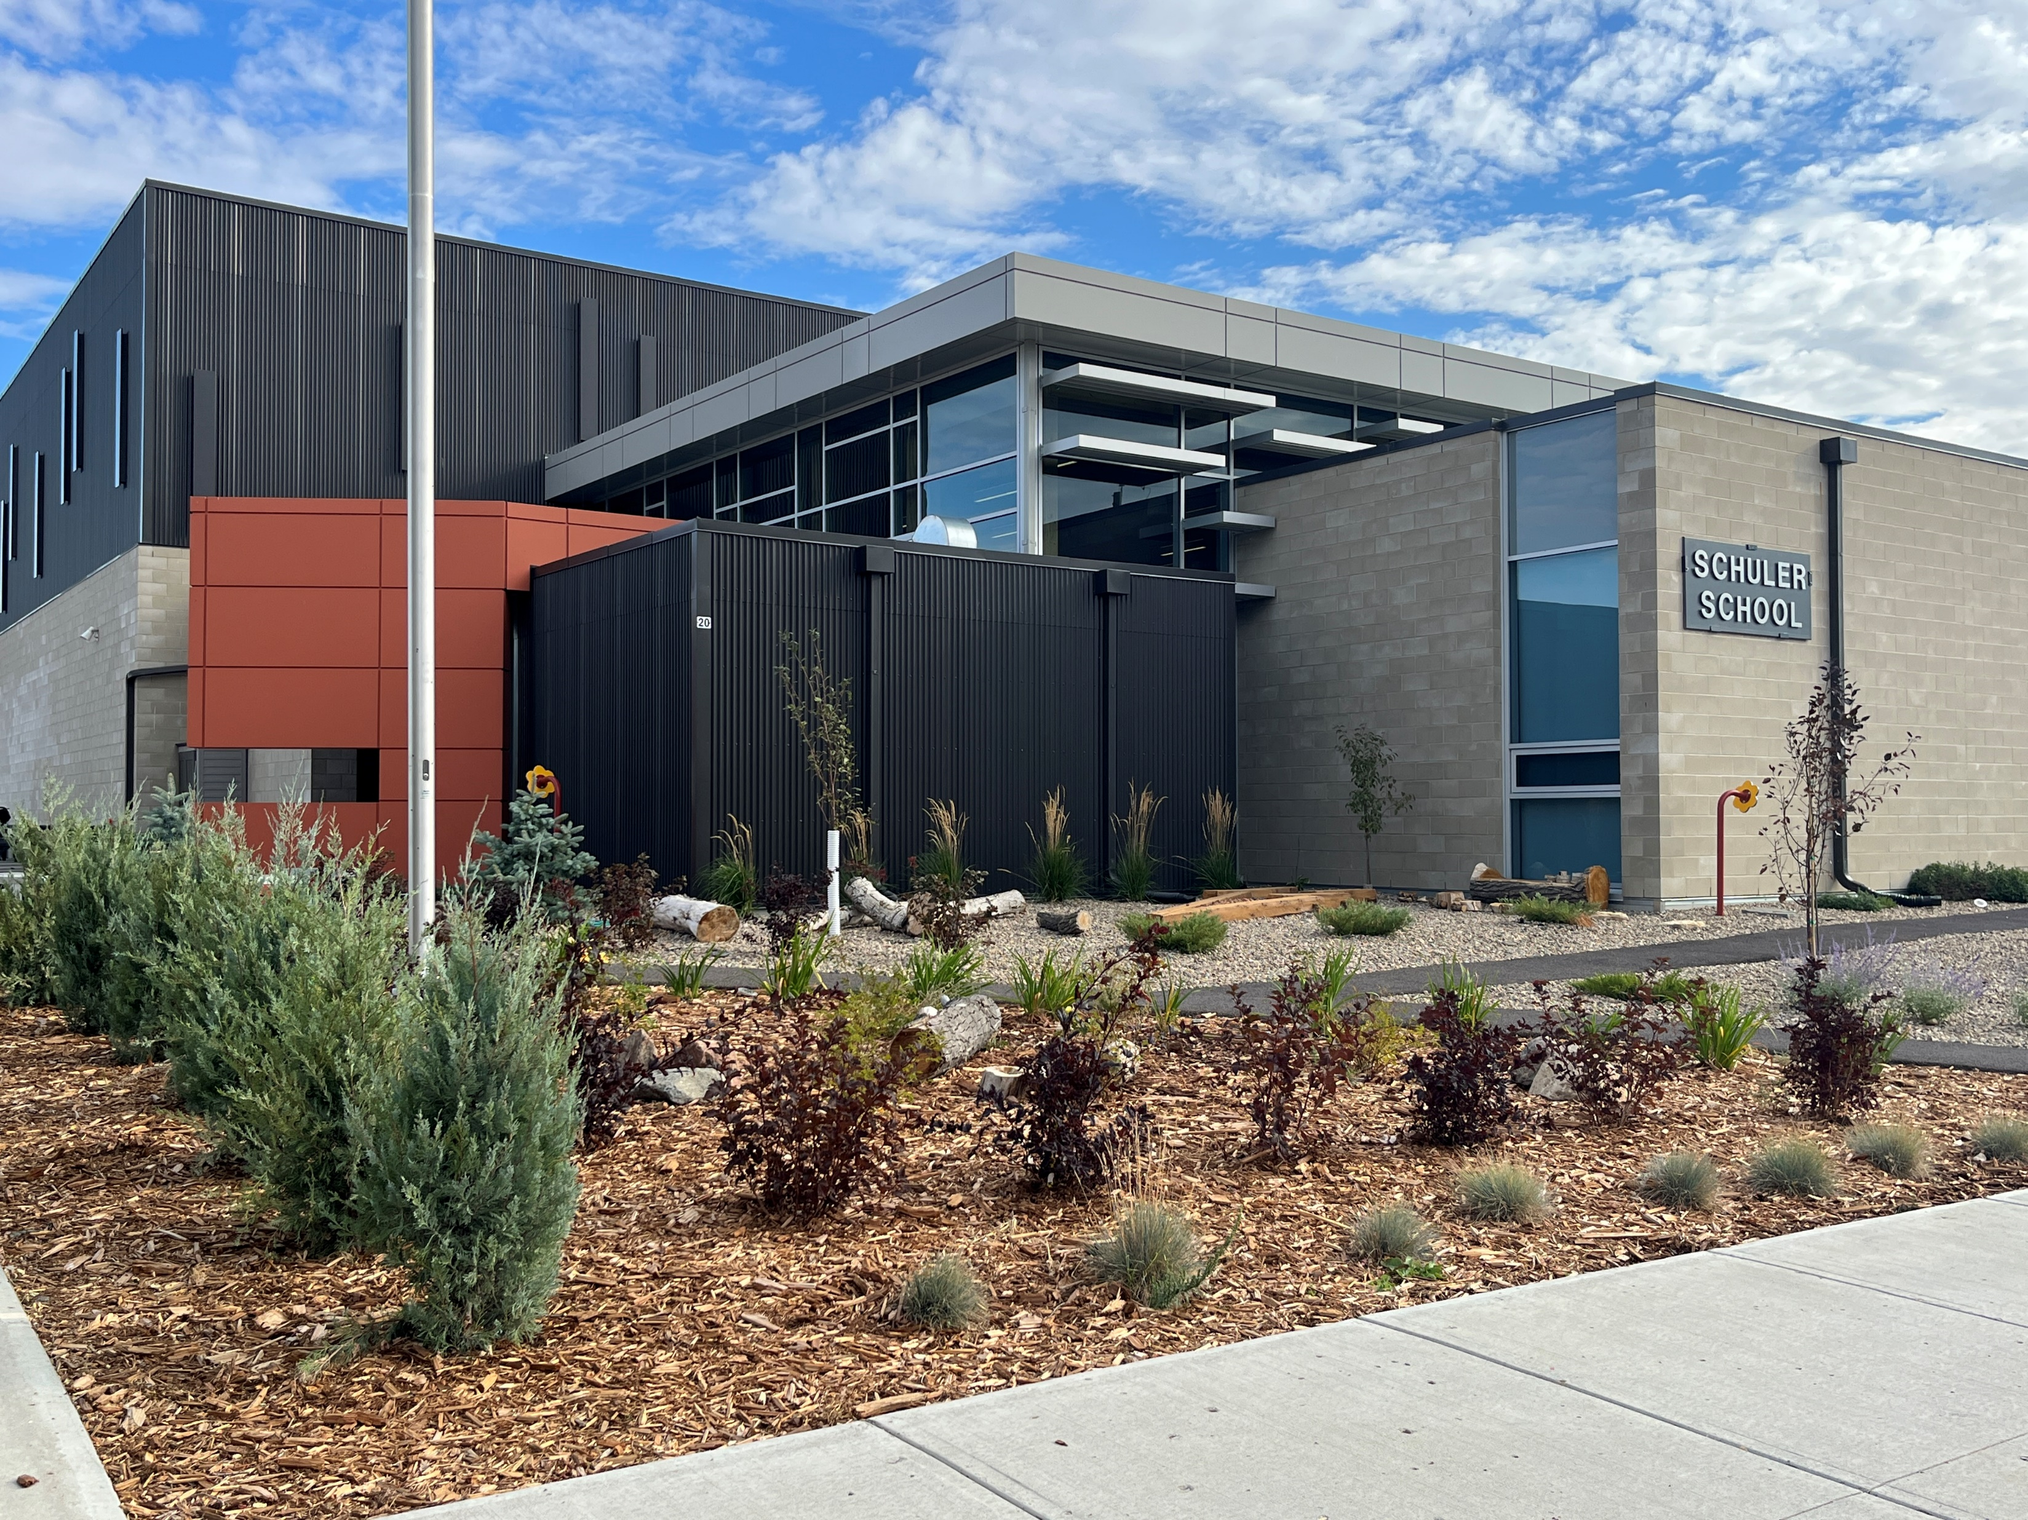
Stay Connected with Us
www.schuler.myprps.com
@SchulerSchoolPRSD8
@SchulerPRSD8

